Slide 1
Calliwriting
박이경
김동희
Team 9

Slide 2
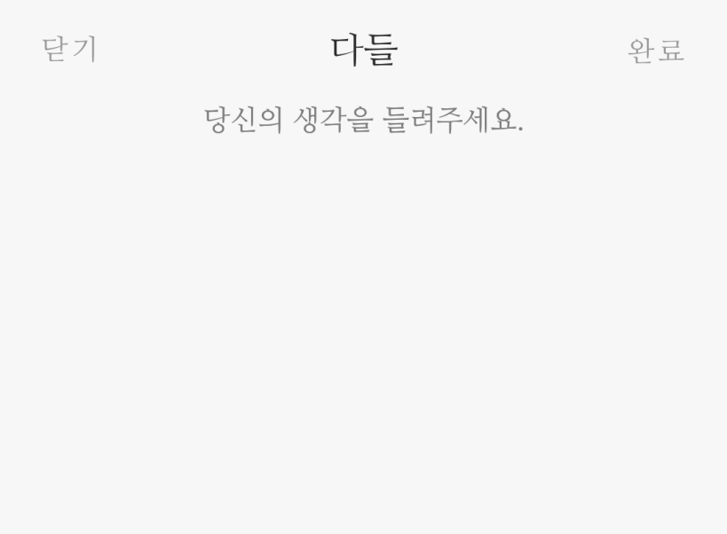
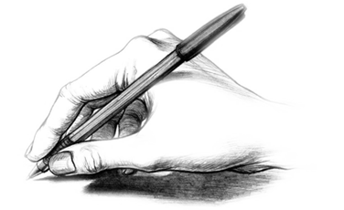
01.
Software description.
Calliwriting software is software for correcting handwriting and practicing calligraphy.

Slide 3
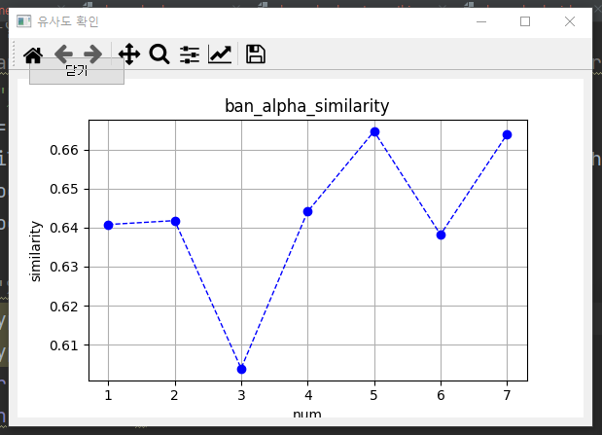



01.
Software description.
Practice sheet
Graph
feedback

Slide 4
02.
Software Demo video + Live Demo

Slide 5
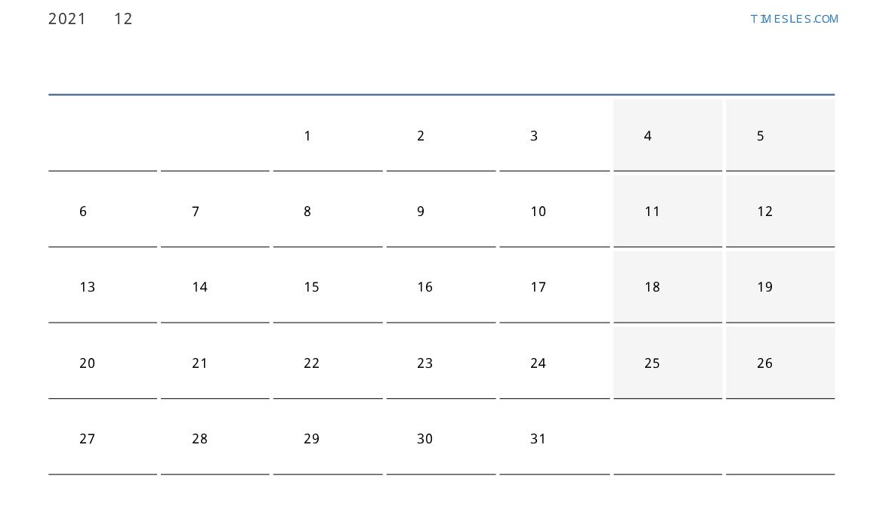
03.
Proposed Milestones and Achieved Steps
Milestone
suggested
Result
Milestone 3 : Receive text images written in real-time
Milestone 4 : Fine-grained feedback + font addition
Milestone 5 : GUI implementation
Choose best image
Customized sentence images in real-time
milestone 3
complete
milestone 4
complete
100%
milestone 5
complete
150%

Slide 6
03.
Proposed Milestones and Achieved Steps
Real-time image loading
Font addition
Ui Implement
Subdivided feedback
+) Graph implementation/
Choose best image⠀⠀
+) Ui Progress

Slide 7
Division of roles
04.
〮 Create study paper 〮 Real-time image loading 〮 UI implementation
Park Leekyung
Developer Ui Designer
〮 Feedback implementation 〮 Graph implementation 〮 UI implementation
Kim Donghee
Developer Ui Designer

Slide 8
05.
Open Source Library Used
PyQt(GPL)
Cv2(Apache 2)
Textwrap (PSF)
calliwriting
Pillow(HPND)
Matplotlib(PSF)
Scikit-image(BSD)

Slide 9
06.
Open Source License Compatibility
 | GPL | Apache | MIT | BSD
GPL | O | O | O | O
Apache | O | O | O | O
MIT | O | O | O | O
BSD | O | O | O | O
+) HPND-GPL : Possible

Slide 10
07.
Open Source License for Calliwriting
Copyright (c) <2021>
This program is free software: you can redistribute it and/or modify it under the terms of the GNU General Public License as published by the Free Software Foundation, either version 3 of the License, or (at your option) any later version.
This program is distributed in the hope that it will be useful, but WITHOUT ANY WARRANTY; without even the implied warranty of MERCHANTABILITY or FITNESS FOR A PARTICULAR PURPOSE. See the GNU General Public License for more details.
You should have received a copy of the GNU General Public License along with this program. If not, see https://www.gnu.org/licenses/.
GPL 3.0 License

Slide 11
Thank you

